Slide 1
Present Perfect Tense
An action that started in the past
The action is still in progress/important
I have lived in Santiago for 10 years
I have studied in Monte de Asìs School since I was 5
She has seen all Harry Potter’s movies
He has participated in all the competitions

Slide 2
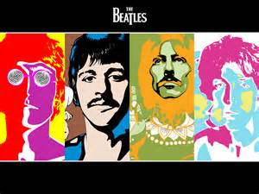
Auxiliary: verb to have + verb in participle
I have listened to the Beatles since I was 5
I haven’t listened to the Beatles
Have you listened to the Beatles?

Slide 3


Expressions: already and yet
Already: used in positive sentences (between the auxiliary have and the participle)
I have already bought you a present
Yet: used in negative sentences and questions (final position)
I haven’t bought your present yet! Sorry!
Have you bought my present yet? No…

Slide 4

Expressions: just
Just: used to refer to actions that happened a short time ago (between have and participle)
I’ve just read your book! It’s amazing!
We’ve just watched that movie. Awful!
She’s just called me!

