Slide 1
REVIEW OF THE ACTIVE VOICE
The structures that we have studied so far are in the
“Active Voice”
The Person does the action

Slide 2
EXAMPLES: (Active voice – Simple past)
The teacher dropped the pen.
Peter invented two new computers.
Bill and Tom wrote a book.

Slide 3
THE PASSIVE VOICE

Slide 4
All the structures we have studied in these examples can be used in the PASSIVE VOICE
The passive - Formal.
The person who does the action is NOT important, or unknown.

Slide 5
  Active voice:
  The teacher dropped the pen.
Passive voice
 |  | by the teacher
PASSIVE VOICE

Slide 6
  The teacher dropped the pen.
The pen |  | by the teacher
PASSIVE VOICE
 | WAS or WERE + Past Participle

Slide 7
THE PEN
WAS or WERE?

Slide 8
THE PEN
WAS + Past Participle

Slide 9

DROP
PAST PARTICIPLE?
DROPPED

Slide 10
  The teacher dropped the pen.
The pen | was dropped | by the teacher
PASSIVE VOICE
 | WAS + Past Participle

Slide 11
Active Voice: The teacher dropped the pen.
Passive Voice: The pen was dropped by the teacher.

Slide 12
Example #2
Peter invented two new computers.
 |  | by Peter
PASSIVE VOICE

Slide 13
Peter invented two new computers.
Two new computers |  | by Peter
PASSIVE VOICE
 | WAS or WERE + Past Participle

Slide 14
Two new computers
WAS or WERE?

Slide 15
Two new computers
WERE+ past participle?

Slide 16
INVENT
PAST PARTICIPLE?
INVENTED

Slide 17
Peter invented two new computers.
Two new computers | were invented |  | by Peter
PASSIVE VOICE
 |  | WERE + Past Participle

Slide 18
Two new computers | were invented |  | by Peter
PASSIVE VOICE
 |  | WERE + Past Participle

Slide 19
Active Voice: Peter invented two new computers.
Passive Voice: Two new computers were invented by Peter.

Slide 20
Example #3
Active voice
Bill and Tom wrote a book.
Passive voice
PASSIVE VOICE
A book
was
written
by Bill and Tom
WAS + past participle

Slide 21
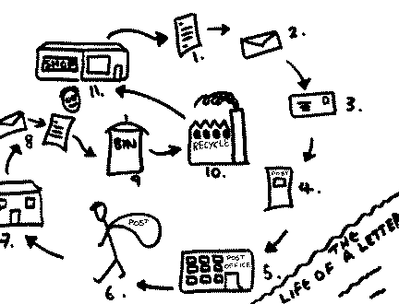
Use the simple past passive voice to write the life of a letter
Example: 1. A letter was written.

